Slide 1
The U.S. Repo Market
January 2016

Slide 2
A STANDARD BILATERAL REPO TRANSACTION
Repurchase (Repo) transactions are agreements between a collateral provider (seller) and a cash investor (buyer) in which the provider sells securities to the investor with a simultaneous agreement to repurchase the securities at an agreed-upon price at a future point in time. The seller is charged interest (at the repo rate) for the use of funds. The cash investor is said to have entered into a reverse repurchase (reverse repo) agreement.
The cash investor requires a buffer against loss by lending out a sum of money less than the market value of the underlying collateral. The margin is the ratio of the value of the collateral posted over the amount of cash minus 1.
Repo is a form of collateralized lending and provides a relatively inexpensive source of funding compared with other short-term money-market instruments.
Date t (opening leg)
Collateral
Provider
$100,000,000 of Treasuries
Cash
Investor
$98,039,215.69 in cash
Date t+1 (closing leg)
Collateral
Provider
$100,000,000 of Treasuries
Cash
Investor
$98,039,760.35 in cash
Repo Trade Details
Term: Overnight | Rate: 10 basis points
Collateral: Treasuries | Margin: 2%
Principal: $100 million
Note: $98,039,760.35 = $98,039,215.69 + ($98,039,215.69 * 1/360 * 10 basis points)
Source: Adapted from “A Primer on the GCF Repo Service: Introduction”, Copeland (2015).

Slide 3
A STANDARD GCF repo trade
A triparty repo involves a clearing bank (in the U.S., Bank of New York Mellon and JP Morgan Chase) that provides back-office support to both parties in the trade. In contrast, in a bilateral repo, each counterparty’s custodian bank is responsible for the clearing and settlement of the trade.
Triparty repo typically assumes a transaction involving general collateral, where the cash investor agrees to accept any securities within an asset class, such as U.S. Treasuries. Bilateral repos, by contrast, typically require that specific securities identified at the CUSIP level be agreed upon when the trade is executed.
GCF (General Collateral Finance) Repo trades settle on a triparty platform. They are characterized by the role of the FICC as a central counterparty.
Date t (opening leg)
Collateral
Provider
$100,000,000 of Treasuries
FICC
$100,000,000 in cash
FICC
$100,000,000 of Treasuries
Cash
Investor
$100,000,000 in cash
Date t+1 (closing leg)
Collateral
Provider
$100,000,000 of Treasuries
FICC
$100,000,277.78 in cash
FICC
$1,000,000,000 of Treasuries
Cash
Investor
$100,000,277.78 in cash
Repo Trade Details
Term: Overnight | Rate: 10 basis points
Collateral: Treasuries | Margin: None
Principal: $100 million
Note: $100,000,277.78 = $100,000,000 + ($100,000,000 * 1/360 * 10 basis points)
Source: Adapted from “A Primer on the GCF Repo Service: Introduction”, Copeland (2015).

Slide 4
The STRUCTURE OF U.S. REPO MARKETS
The U.S. Repo market is part of the collateralized U.S.-dollar-denominated money markets and plays a critical role in the trading of fixed-income securities.
The Repo market matches financial institutions that are long cash such as Money market mutual funds (MMFs), Corporate treasuries and Custodial agents to institutions that are short of cash such as dealers and hedge funds.
Security dealers play a critical intermediation role in the Repo market through facilitating the exchange of securities for cash among participants.
Triparty repo markets are considered more cost efficient, while bilateral repo is preferred if two parties wish to interact directly with each other or if specific collateral is requested.
U.S. Repo Market
Bilateral repo market
Bilateral cash investors:
Hedge funds
Asset managers
others
Securities
dealers
Prime Brokerage Clients
Hedge funds
Others
Triparty cash investors:
Money market mutual funds
Securities lenders
Others
GCF
Cash
Securities
Tri-party
repo markets
A clearing bank settles the repo on its balance sheet and provides collateral management
Source: Adapted from “A Reference Guide to U.S. Repo and Securities Lending Markets”, Baklanova et al (2015).

Slide 5
THE U.S. REPO MARKET IS OF SIGNIFICANT SIZE
U.S. repo market volumes can be divided into two segments, based on differences in settlement: triparty repo and bilateral repo.
GCF Repo is considered part of triparty repo as it settles on the triparty platform. It is designed for FICC’s netting members to trade cash and securities amongst themselves based on negotiated rates and terms.
A repo trade between primary dealers shows up twice in Federal Reserve data as repo and reverse repo, representing both sides of the trade. Summing both numbers would result in double-counting.
Some repo activity takes place without a dealer acting as an intermediary as with the Fed’s RRP program. This facility allows financial institutions to invest cash directly with the Fed on a tri-party basis. The most active RRP participants are MMFs.
 |  | Asset |  | Liabilities
 |  | Reverse Repo |  | Repo
 |  | $ billions | % | $ billions | %
Dealer Repo | Triparty (Total) | 305 | 13% | 1,839 | 54%
 | exGCF | - | 0% | 1,534 | 45%
 | GCF | 305 | 13% | 305 | 9%
 | Fed* | - | 0% | - | 0%
 | Bilateral | 1,945 | 82% | 1,576 | 46%
 | Dealer Total | 2,250 | 95% | 3,415 | 100%
Non dealer Repo | Triparty (Total) | 127 | 5%
 | Fed** | 127 | 5%
 | Non-Dealer Total | 127 | 5%
Grand Total | 2,377 |  | 3,415
* Primary dealer participation in the Fed’s RRP program is de minimus.
**The Fed’s RRP program is the average daily outstanding of the overnight and term RRP from January 1st 2015 to June 10th, 2015.
Source: Adapted from “A Reference Guide to U.S. Repo and Securities Lending Markets”, Baklanova et al (2015). Data is as of June 2015.

Slide 6
U.S. TREASURIES ARE THE DOMINANT SOURCE OF COLLATERAL FOR REPOS
Treasury securities make up ~80% of the collateral posted in bilateral repo. Other securities, such as agency mortgage-backed securities (MBS), agency debt, corporate bonds, and equities, are posted as collateral in bilateral repo trades, but only to a limited extent.
In contrast to bilateral repo, Treasury securities play a much smaller role in the triparty repo. Treasury securities are posted as collateral for about 40% of triparty repo trades, roughly the same share as Agency MBS.
COLLATERAL FOR REPO
(Dollars in billions)
Total Repo
US Treasury securities including STRIPS All other assets
Sources: For total repo, Federal Reserve Form FR2004; for tri-party repo and GCF repo, Federal Reserve Bank of New York.
Notes: Total repo estimates are based on Federal Reserve 2004 data as of October 8, 2014.
Tri-party repo and GCF repo data are as of October 9, 2014. Bilateral repo estimates are a residual amount, equal to total repo minus tri-party repo minus GCF repo.

Slide 7
DEALERS HAVE REDUCED THEIR PARTICIPATION IN AGENCY MBS REPO
The amount of balance sheet devoted to Agency MBS Repo by primary dealers has fallen by nearly 50% since April 2013 because of regulatory developments.
There has also been a decrease in the relative share of term repo over the same time period.
AGENCY MBS REPO FOR PRIMARY DEALERS
(Dollars in billions)
Outstanding Agency MBS Repo ($bb)
Agency MBS Repo by Term
Source: Federal Reserve Bank of New York.

Slide 8
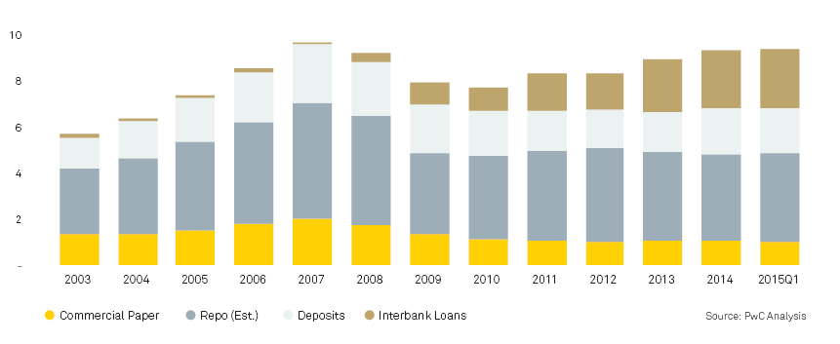
REPO STILL PLAYS A SIGNIFICANT ROLE IN SHORT-TERM WHOLESALE FUNDING MARKETS
Banks and other financial institutions have access to a range of borrowed funds to service their needs that can be broadly categorized into retail and wholesale funding. Wholesale funding corresponds to the use of federal funds, deposits from large institutions, and debt issuance. Retail funding refers to deposits that households and small companies keep with a bank.
The short-term wholesale funding market consists of two segments: secured and unsecured. Secured funding consists of Repo and Asset-backed Commercial Paper. Unsecured funding consists of Commercial Paper, CDs, and Deposits.
Leading up to the financial crisis, market participants increasingly relied on wholesale funding. The 2007-2009 crisis dramatically decreased the use of CP, while the interbank market has grown substantially. While activity in the repo markets dropped sharply post-Crisis, repo remains the largest component of wholesale funding markets.
THE U.S. SHORT-TERM WHOLESALE FUNDING MARKET
(Dollars in trillions)

Slide 9
BASEL III HAS A SIGNIFICANT IMPACT ON REPO ACTIVITY FOR G-SIBs
The Basel III regulatory landscape has reshaped the economics of repo for global systemically important banks (G-SIBs) in particular through the introduction of the enhanced Supplementary Leverage Ratio (eSLR). In general, SLR is the most direct driver of capital held against repo positions.
Most market participants hold SLR responsible for declines in repo market liquidity and expect further decreases going forward.
Before Basel III, repo was an almost capital free business. Post-Crisis, the emphasis of desk-level capital allocation exposes repo to the economics of a standalone business.
Supplementary
Leverage Ratio (SLR)
Liquidity Coverage Ratio (LCR)
Net Stable Funding Ratio (NSFR)
Tier 1 Capital
Total Leverage Exposure
High Quality Liquid Asset
Net Cash Outflow over a 30 day Stress Period
Available Stable Funding
Required Stable Funding
REGULATION | GENERAL EFFECT (G-SIBs) | EFFECT ON REPO | IMPLEMENTATION
SLR | Limit supply of balance sheet Increase Tier 1 capital Reduce off-balance sheet exposures Cost of holding cash becomes more expensive | Grosses up the balance sheet Increases capital needed against repo transactions Likely impacts capital allocated to repo | 2015, disclosure began 2018, banks must be compliant to SLR and eSLR
LCR | Increases supply of liquidity to survive a short-term (one month) stress scenario Requires banks to hold unencumbered HQLA Cost of holding cash becomes more expensive | Reduces the supply of HQLA collateral Limits amount firms can assume as automatic or rollovers Makes short term funding more expensive due to corresponding HQLA requirement Pushes repo out from overnight to term | U.S. banks fully compliant by 2017 Phase-in transition with 80% by 2015, 90% by 2016, and 100% by 2017
NSFR | Increases supply of liquidity to survive a long term (one year) scenario | Pushes repo out to longer term Increases the cost of repo Discourages match books | Rule has not been proposed in the U.S.; although international standards mandate compliance by 2018
Source: “The Future of Wholesale Funding Markets”, PWC and BNY Mellon, December 2015

Slide 10
QUANTIFYING THE IMPACT OF SLR ON REPO
The risk-weighted capital requirement takes into account the mitigation provided by the bond collateral (net of a volatility adjustment) and the riskiness of the broker-dealer as counterparty.
The SLR is based solely on market value and doesn’t differentiate at all across risk assets – all assets require a 5% capital allocation.
The leverage requirement also penalizes the under-collateralization of the bank’s exposure to the broker-dealer.
In this simple example, the LR would increase the risk-weighted capital requirement by 13.5x.
Repo
Counterparty
(e.g. broker-dealer)
Bonds (95)
Reverse Repo
Counterparty
(e.g. bank)
Cash (100)
Risk-weighted capital requirement |  |  | LR capital requirement
Bank gross exposure to broker-dealer | 100 | 100 | Bank gross exposure to broker-dealer
Bond collateral received | (95) | 5 | Under-collateralization
Collateral volatility adjustment (5% * 95) | 4.75
Bank net exposure to broker-dealer | 9.75 | 105 | Bank total exposure to broker-dealer
Broker-dealer exposure risk-weight | 20%
Risk-weighted asset | 1.95
Target Tier 1 capital ratio | 12% | 5% | Minimum Tier 1 LR (for G-SIBs)
Tier 1 capital requirement | 0.23 | 5.25 | 22.8 times increase
Source: Adapted from “Leverage Ratio: the impact on securities financing transactions”, PwC, February 2014

Slide 11
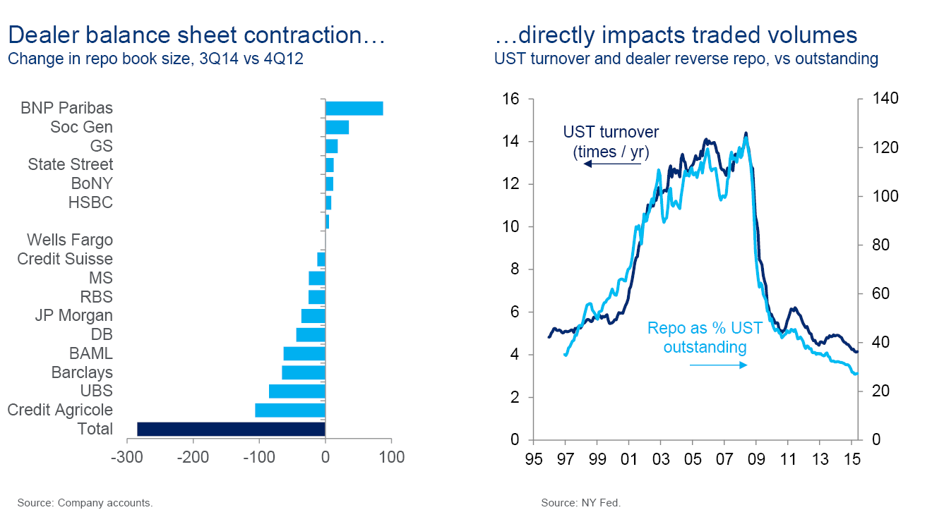
LESS REPO MEANS LESS RELATIVE VALUE TRADING
Broker-dealer balance sheets and in particular the size of the repo book have shrunk significantly because of Basel III requirements. This contraction in repo has impacted liquidity in fixed income markets and in particular made relative value trading much more challenging.
The recent phenomenon of negative swap spreads can in part be attributed to balance sheet pressures.
LEVERAGE, REPO AND LIQUIDITY
Source: “When agents lose their principals”, Matt King, CitiResearch.

Slide 12
THE ONGOING EVOLUTION OF REPO
Repo settlement mechanisms can be viewed as a continuum ranging from bilateral to centrally cleared.
The main role of tri-party agents is to coordinate settlement between collateral providers and cash investors. The tri-party agent maintains custody of the collateral, processes payment and delivery between the provider and the investor, along with other services.
The clearing house lite model provides risk mutualization and loss waterfalls without full novation.
Bilateral
Repo
Tri-party
Repo
Clearing
House Lite
Centrally
Cleared Repo
Documentation | Individual GMRAs | GMRAs and CRMAs Clearing bank agreements | GRMAs, clearing bank agreements Membership agreements | Clearing house rules CPP membership agreements
Trade Execution | Collateral eligibility defined by cash lender Trade details: repo term, haircut, and interest charged |  | Anonymous counterparty Repo term and interest determined by cash investor | OTC platform Determined by counterparties (e.g., tenor of trade)
Trade Confirmation | Back offices confirm to cash and collateral providers | Three-way deal matching
Collateral Management | Substitution is allowed but cumbersome | Repos segregated until unwind | Collateral is restricted to Fed-eligible securities Netting of collateral and cash | Ability of the CCP to reliably price Netting of collateral and cash
Clearing / Settlement | Counterparties execute on a Delivery vs. Payment (DvP) basis | Clearing bank segregates securities, manages the transfer of cash/collateral and unwind Auto-substitution of collateral
Liquidation | Cash lender must liquidate the collateral on the open market Cash lender exposed to a loss if the haircut/collateral incorrectly valued |  | Clearing house facilitates liquidation Participant-funded default fund | CCP hedges and can retain positions into the future Participant-funded default fund
Risk Management | Cash/collateral providers each responsible for counterparty collateral monitoring | Clearing bank monitors pledged collateral with daily revaluations and margin management | Counterparty risk remains between collateral provider and cash lender | Trade novated by CCP, mitigating individual counterparty risk
Participations | Predominantly broker dealers and their prime brokerage (PB) clients | Government, broker dealers (BDs), MMFs, alternatives, corporates, other financial institutions | Broker dealers & their clients (PB clients) other financial institutions, MMFs, alternatives | Broker dealers & expanded clearing house members (MMFs, alternatives)
Source: “The Future of Wholesale Funding Markets”, PwC and BNY Mellon, December 2015

